Slide 1
LECTURE # 1
COURSE OBJECTIVES
Express statements with the precision of formal logic
  Analyze arguments to test their validity
  Apply the basic properties and operations related to sets
  Apply to sets the basic properties and operations related to relations and functions
  Define terms recursively
  Prove a formula using mathematical induction
  Prove statements using direct and indirect methods
  Compute probability of simple and conditional events.
  Identify and use the formulas of combinatory in different problems
  Illustrate the basic definitions of graph theory and properties of graphs
  Relate each major topic in Discrete Mathematics to an application area in computing
RECOMMENDED BOOKS
Discrete Mathematics with Applications (second edition) by Susanna S. Epp
Discrete Mathematics and Its Applications (fourth edition) by Kenneth H. Rosen
Discrete Mathematics by Ross and Wright

Slide 2
MAIN TOPICS
1. Logic.
2. Sets and Operations on sets.
3. Relations and Their Properties.
4. Functions.
5. Sequences and Series.
6. Recurrence Relations.
7. Mathematical Induction.
8. Loop Invariants.
9. Loop Invariants.
10. Combinatorics.
11. Probability.
12. Graphs and Trees.
What is Discrete Mathematics?
  Discrete Mathematics concerns processes that consist of a sequence of individual steps.
  This distinguishes it from calculus, which studies continuously changing processes. While the ideas of calculus were fundamental to the science and technology of the industrial revolution, the ideas of discrete mathematics underline the science and technology specific to the computer age.
LOGIC
  Logic is the study of the principles and methods that distinguishes between a valid and an invalid argument.
  Now what do we mean by the valid and invalid argument, we will study in our next Lectures.
SIMPLE STATEMENT
  A statement is a declarative sentence that is either true or false but not both.
  A statement is also referred to as a proposition. So when we say a statement or Proposition this must be clear to you that these are the same.

Slide 3
EXAMPLES OF STATEMENTS OR PROPOSITIONS:
  If a proposition is true, we say that it has a truth value of "true”.
  If a proposition is false, its truth value is "false".
  The truth values “true” and “false” are, respectively, denoted by the
  letters T and F.
  Grass is green.
  Grass is green is a statement (or proposition) because the sentence is true and its truth value is T.( Because everyone knows that grass is green)
  4 + 2 = 6
  4 + 2 = 6 is also a statement and its truth value is T.(Because 4+2 is 6)
  3. 4 + 2 = 7
  4 + 2 = 7 is also a statement and its truth value is F. ( Because we know that 4+2 is 6 not 7).Here you should note that both 2 and 3 are statements although 4+2=7 is mathematically wrong.
  4. There are four fingers in a hand.
  There are four fingers in a hand is also a statement and its truth value is false.
  5. Washington, D.C, is the capital of the United States of America.
  The above statement is also a proposition and its truth value is T.
  6. Karachi is the capital of Pakistan. Karachi is the capital of Pakistan is also a statement and its truth value is F.
  7. Pervaiz Musharaf is the president of America.
  The above sentence is a statement and its Truth value is false.
  REMARK: Every sentence is not a statement.

Slide 4
EXAMPLES OF SENTENCES WHICH ARE NOT PROPOSITIONS:
  Consider the following sentences
  Close the door.
  x is greater than 2.
  He is very rich
  What time is it ?
  Read this carefully.
  x + z = 10
  are not propositions.
  REMARK:
  If sentence is a question or command , or it is vague or nonsensical, then it cannot be classified as true or false then the sentence cannot be a statement or proposition, as easily seen in the above sentences.
  The statements which involve variable or pronoun and there are some information about the variable or pronoun which make the role of variable clear then the sentence becomes statement.
  For example in the last sentence if we say that x=3 and z=7 then this become a statement and its truth value is T and if we say x=8 and z=4 then the sentence has its truth value as F.
  Here is the rule given below
  RULE
  If the sentence is preceded by other sentences that make the pronoun or variable reference clear, then the sentence is a statement.

Slide 5
  EXAMPLES
  x = 1 is a sentence which gives us the information about the variable which is in the below sentence. .
  x > 2 now using the value above we can see that our sentence takes the form 1 > 2 now we can talk about its truth value . So
  x > 2 is a statement with truth-value FALSE.
  Similarly in the next example
  Bill Gates is an American
  He is very rich.
  He is very rich is a statement with truth-value TRUE.
UNDERSTANDING STATEMENTS
  x + 2 is positive.
  The above sentence is not a statement because it is true for some value of x and false for some values of x. We can say that the truth value of the statement is vague
  2. May I come in?
  The above sentence is permission and hence we can't talk about its truth values so it is also not a statement.
  Logic is interesting.
  Logic is interesting is a statement because logic is interesting and its truth value is T.
  It is hot today.
  It is hot today is also a statement because whenever we say this sentence then that day either hot or not so we can assign a truth value to this sentence.
  5. -1 > 0 is also a statement with truth value F
  x + y = 12 is not a statement.

Slide 6
COMPOUND STATEMENT
Simple statements could be used to build a compound statement.
EXAMPLES
“3 + 2 = 5” and “Lahore is a city in Pakistan”
Here 3 + 2 = 5 is a statement and Lahore is a city in Pakistan is another statement we combine these two statements by using and to form another statement and you can talk about its truth value. Similarly in the next example we combine two statements by using or to form another statement.
2. “The grass is green” or “ It is hot today”
“Discrete Mathematics is not difficult to me”
Here the original statement is Discrete Mathematics is difficult to me and we form the new statement by using not.
AND, OR, NOT are called LOGICAL CONNECTIVES.
SYMBOLIC REPRESENTATION
Statements are symbolically represented by letters such as p, q, r,...
  EXAMPLES
  p = “Islamabad is the capital of Pakistan”
  q = “17 is divisible by 3”

Slide 7
LOGICAL CONNECTIVES
CONNECTIVE | MEANINGS | SYMBOL | CALLED
Negation | not | ~ | Tilde
Conjunction | and | ∧ | Hat
Disjunction | or | ∨ | Vel
Conditional | if…then… | → | Arrow
Biconditional | if and only if | ↔ | Double arrow
  EXAMPLES
  p = “Islamabad is the capital of Pakistan”
  q = “17 is divisible by 3”
  p ∧ q = “Islamabad is the capital of Pakistan and 17 is divisible by 3”
  p ∨ q = “Islamabad is the capital of Pakistan or 17 is divisible by 3”
  ~p = “It is not the case that Islamabad is the capital of Pakistan” or simply “Islamabad is not the capital of Pakistan”
TRANSLATING FROM ENGLISH TO SYMBOLS
Let p = “It is hot”, and q = “ It is sunny”
SENTENCE SYMBOLIC FORM
It is not hot. ~ p
2. It is hot and sunny. p ∧q
3. It is hot or sunny. p ∨ q
4. It is not hot but sunny. ~ p ∧q
5. It is neither hot nor sunny. ~ p ∧ ~ q

Slide 8
EXAMPLE
  Let h = “Zia is healthy”
  w = “Zia is wealthy”
  s = “Zia is wise”
  Translate the compound statements to symbolic form:
  STATEMENTS SYMBOLIC FORM
  Zia is healthy and wealthy but not wise. (h ∧ w) ∧ (~s)
  2. Zia is not wealthy but he is healthy and wise. ~w ∧ (h ∧ s)
  3. Zia is neither healthy, wealthy nor wise. ~h ∧ ~w ∧ ~s
TRANSLATING FROM SYMBOLS TO ENGLISH
  Let m = “Ali is good in Mathematics”
  c = “Ali is a Computer Science student”
  Translate the following statement forms into plain English:
  STATEMENT FORM STATEMENT
  ~ c Ali is not a Computer Science student.
  2. c ∨ m Ali is a Computer Science student or good in Maths.
  3. m ∧ ~ c Ali is good in Maths but not a Computer Science student.

Slide 9
TRUTH TABLE
  A convenient method for analyzing a compound statement is to make a truth table for it.
  A truth table specifies the truth value of a compound proposition for all possible truth values of its constituent propositions.
  The truth values “true” and “false” are respectively denoted by the letters T and F.
NEGATION (~)
  If p is a statement variable, then negation of p, “not p”, is denoted as “~p”
  It has opposite truth value from p i.e., if p is true, ~p is false; if p is false,
  ~p is true.
  EXAMPLES
  “Ali is not a Computer Science student” then its negation is “Ali is a computer Science student”
  “I like my course of Discrete mathematics ”then its negation is “I don't like my Discrete mathematics course”
  “2 + 3 is equal to 5” then its negation is “2 + 3 is not equal to 5”
TRUTH TABLE FOR
~ p
p | ~ p
T | F
F | T

Slide 10
CONJUNCTION (∧)
  If p and q are statements, then the conjunction of p and q is “p and q”, denoted as “p ∧ q”.
  It is true when, and only when, both p and q are true. If either p or q is false, or if both are false, p∧q is false.
  Note that in the table T is only in that row where both p and q have T
  and all other values are F. Thus for finding out the truth values for the conjunction of two statements we will only first search out where the
  both statements are true and write down the T in the corresponding row
  in the column of p ∧ q and in all other rows we will write F in the
  column of p ∧ q.
p | q | p ∧ q
T | T | T
T | F | F
F | T | F
F | F | F
DISJUNCTION (∨) or INCLUSIVE OR
  If p and q are statements, then the disjunction of p and q is “p or q”, denoted as “p ∨ q”
  It is true when at least one of p or q is true and is false only when both p and q are false.

Slide 11
SUMMARY
Note that in the table F is only in that row where both p and q have F and all other values are T. Thus for finding out the truth values for the disjunction of two statements we will only first search out where the both statements are false and write down the F in the corresponding row in the column of p ∨ q and in all other rows we will write T in the column of p ∨ q.
Remark:
Note that for Conjunction of two statements we find the T in both the statements, But in disjunction we find F in both the statements. In other words we will fill T first in the column of conjunction and F in the column of disjunction.
What is a statement?
How a compound statement is formed.
Logical connectives (negation, conjunction, disjunction).
How to construct a truth table for a statement form.

Slide 12
22C:19 Discrete Math
Logic and Proof

Slide 13
Predicate Logic
Propositional logic has limitations. Consider this:
Is x > 3 a proposition? No, it is a predicate. Call it P(x).
P(4) is true, but P(1) is false.
P(x) will create a proposition
when x is given a value.
Predicates are also known as propositional functions.
Predicate logic is more powerful than propositional logic
subject
predicate

Slide 14
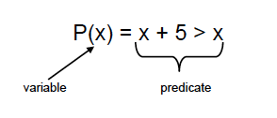
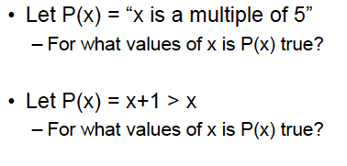
Predicate Logic

Slide 15
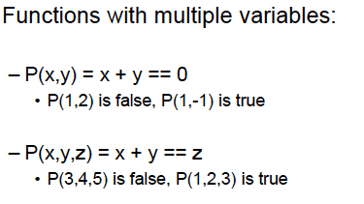
Examples of predicates

Slide 16
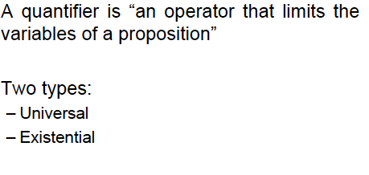
Quantifiers

Slide 17
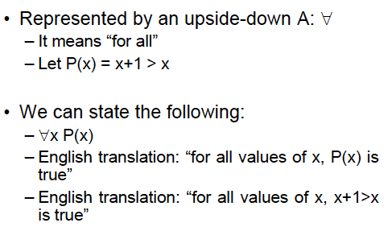
Universal Quantifiers

Slide 18
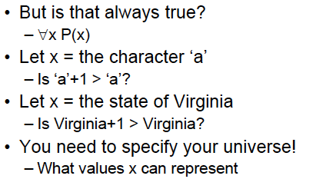
Universal Quantifiers
Perhaps we meant all real numbers.

Slide 19
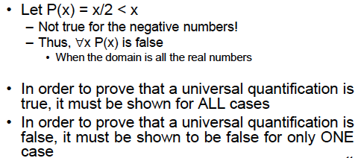
Universal Quantifiers

Slide 20
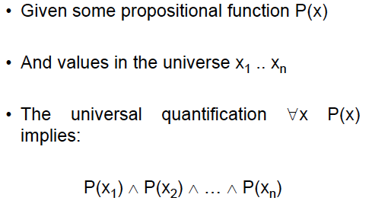
Universal Quantifiers

Slide 21
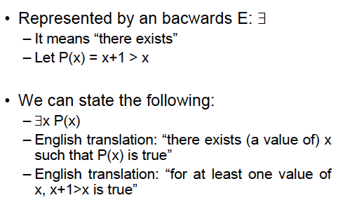
Existential Quantifiers
∃x (x is a student in 22C:19 ⟶ x has traveled abroad)

Slide 22
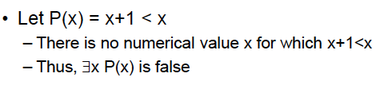
Existential Quantifiers
Note that you still have to specify the domain of x.
Thus, if x is Iowa, then P(x) = x+1 > x is not true.

Slide 23
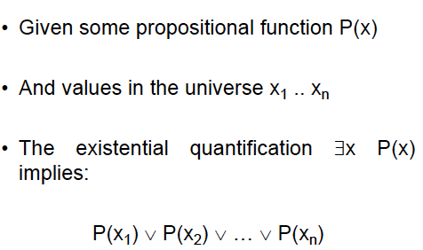
Existential Quantifiers

Slide 24
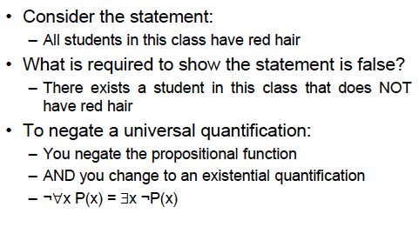
Negating quantification

Slide 25
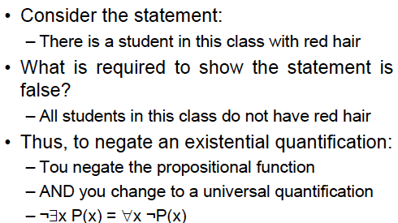
Negating quantification
You

Slide 26

Translating into English
Every student x in this class has studied Calculus.
Let C(x) mean “x has studied Calculus,” and
S(x) mean “x is a student in this class.”

Slide 27
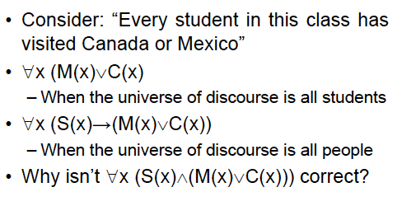
Translating into English

Slide 28
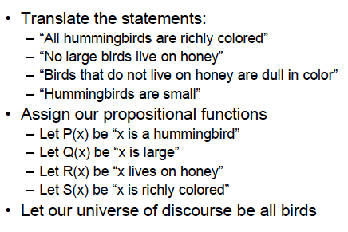
Translating into English

Slide 29
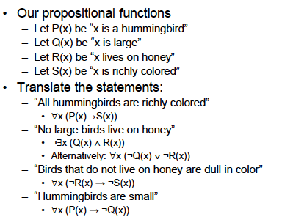
Translating into English

Slide 30
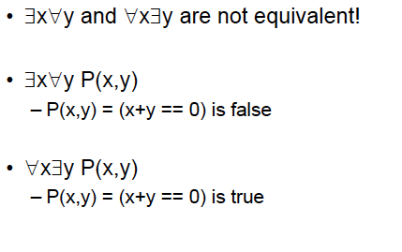
Order of Quantifiers

Slide 31
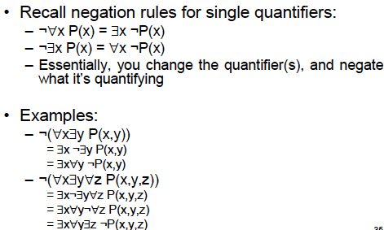
Negating Multiple Quantifiers

Slide 32
More on Quantifiers
∀x ∃y ( x + y = 10 )
∀x ∀y ( x + y = y+ x )
Negation of ∀x P(x) is ∃x (P(x) is false)
(there is at least one x such that P(x) is false)
Negation of ∃x P(x) is ∀x (P(x) is false)
(for all x P(x) is false)

Slide 33
Rules of Inference
p (Let p be true)
p ⟶ q (if p then q)
q (therefore, q is true)
Corresponding tautology [p ⋀ (p⟶ q)] ⟶ q
What is an example of this?

Slide 34
Other Rules of Inference
[(p ⟶ q) ⋀ (q ⟶ r)] ⟶ (p ⟶ r)
[(p ⋁ q) ⋀ ¬ p] ⟶ q
(p ⋀ q) ⟶ p
[(p ⋁ q) ⋀ (¬ p ⋁ r) ⟶ q ⋁ r
(if p is false then q holds, and if p is true then r holds)
Find example of each
Read page 66 of the book

Slide 35
Rules of Inference
¬ q (Let q be false)
p → q (if p then q)
¬ p (therefore, p is false)
Corresponding tautology [¬ q ⋀ (p→ q)] → ¬ p
What is an example of this?

Slide 36
Proofs
To establish that something holds.
Why is it important?
What about proof by example, or proof by simulation, or proof by fame? Are these valid proofs?

Slide 37
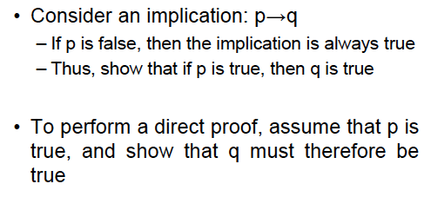
Direct Proofs

Slide 38
Direct Proofs
Example. Prove that if n is odd then n² is odd.
Let n = 2k + 1,
so, n² = 4k² + 4k + 1 = 2 (2k² + 2k) + 1
By definition, this is odd.
Uses the rules of inference

Slide 39
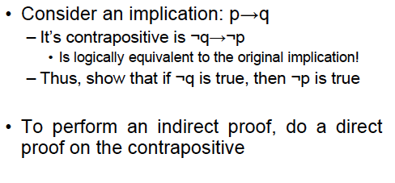
Indirect Proofs

Slide 40
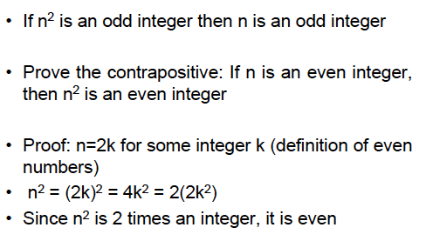
Indirect Proof Example

Slide 41
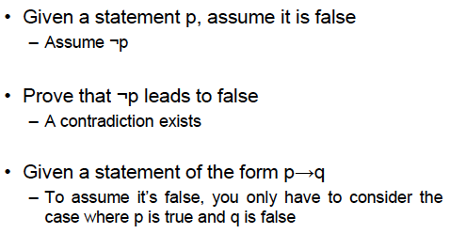
Proof by Contradiction

Slide 42
Proof by contradiction: Example
Assume that the statement of the theorem is false. Then show that something absurd will happen
Example. If 3n+2 is odd then n is odd
Assume that the statement is false. Then n= 2k.
So 3n+2 = 3.2k + 2 = 6k+2 = 2(3k + 1).
But this is even! A contradiction!
This concludes the proof.

Slide 43
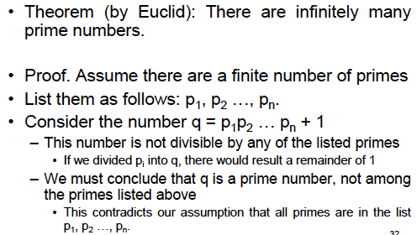
Proof by contradiction: Example

Slide 44
Proof by contradiction: Example
Example. Prove that square root of 2 is irrational.
Assume that the proposition is false.
Then square root of 2 = a/b (and a, b do not have a common factor)
So, 2 = a²/b²
So, a² = 2b². Therefore a² is even. So a = 2c
So 2b² = 4c² . Therefore b² = 2c^{2.} Therefore b² is even. This means b is even.
Therefore a and b have a common factor (2)
But (square root of 2 = a/b) does not imply that.

Slide 45
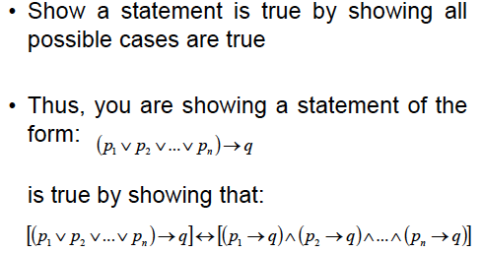
Exhaustive proof

Slide 46
Exhaustive proof
Example. If n is a positive integer, and n ≤ 4, then (n+1) ≤ 3^{n}
Prove this for n=1, n=2, n=3, and n=4, and you are done!
Note. Such a proof is not correct unless every possible case is considered.

Slide 47
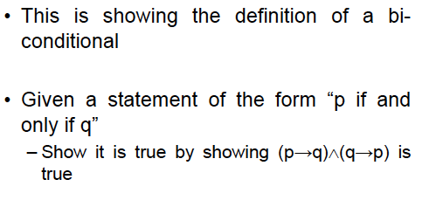
Proof of Equivalence

Slide 48
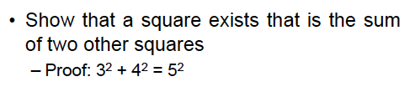
Existence Proofs
Constructive Proof
Non-constructive Proof

Slide 49
Mistakes in proofs
a=b
So, a² = ab
Therefore a² - b² = ab – b²
So, (a+b).(a-b) = b.(a-b)
Therefore a+b = b
So, 2b = b
This implies 2 = 1
What is wrong here?

Slide 50
Counterexample
If you find a single counterexample, then immediately the proposition is wrong.

Slide 51
Difficult problems
Fermat’s last theorem
The equation
x^{n} + y^{n} = z^{n}
  does not have an integer solution for x, y, z when
  x ≠ 0 , y ≠ 0 , z ≠ 0 and n > 2
  (The problem was introduced in 1637 by Pierre de Fermat. It remained unsolved since the 17th century, and was eventually solved around 1990 by Andrew Wiles)

